Slide 1



Slide 2
SUPPLIER OF CUSTOMIZED
MARKING SYSTEMS!

Slide 3
LET US PRODUCE YOUR SYSTEM
FAST, RELIABLE AND
ACCORDING TO YOUR
INDIVIDUAL REQUIREMENTS

Slide 4
YOU JUST NEED TO
SEND AN EXCEL FILE
WAIT FOR DELIVERY
ASSEMBLE THE MARKING

Slide 5

5-7
DAYS FOR
DELIVERY FOR GERMANY
HOW IT WORKS
Excel file
CUSTOMER
ORDERING

Slide 6
ORDERING
CREATE AN EXCEL FILE WITH TEXT INFORMATION AND QUANTITY FOR EACH MARKER

Slide 7
 | A (TEXT FIELD 1) | B (TEXT FIELD 2) | C (QUANTITY)
1 | FLEXIMARK | 1 | 10
2 | FLEXIMARK | 2 | 15
3 | FLEXIMARK | 3 | 20
EXAMPLE
EXCEL FILE
FLEXIMARK
1
= 10 UNITS OF MARKERS
FLEXIMARK
2
= 15 UNITS OF MARKERS
FLEXIMARK
3
= 20 UNITS OF MARKERS

Slide 8
ORDERING
SUBMIT THE EXCEL FILE WITH THE STANDARD ORDER

Slide 9
ORDERING
CUSTOMIZED MARKINGS ARE DELIVERED IN 5-7 DAYS FOR GERMANY

Slide 10
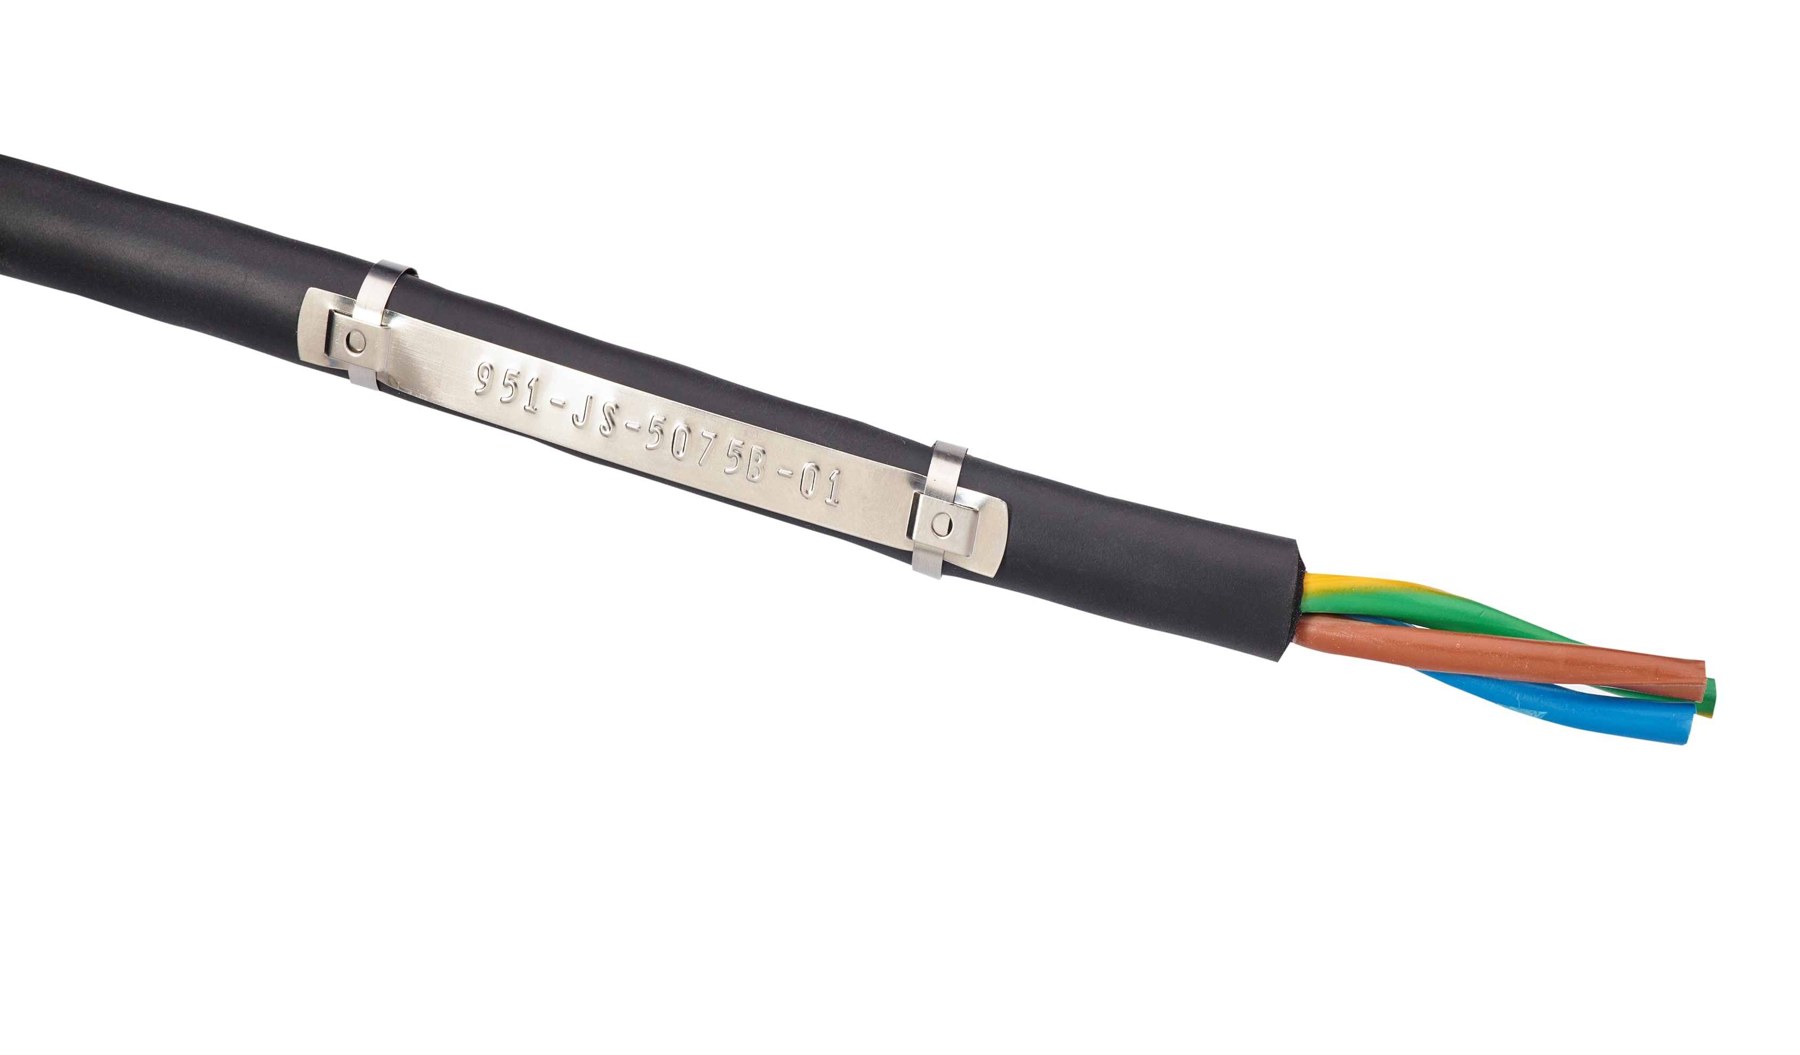
PRODUCTION

Slide 11
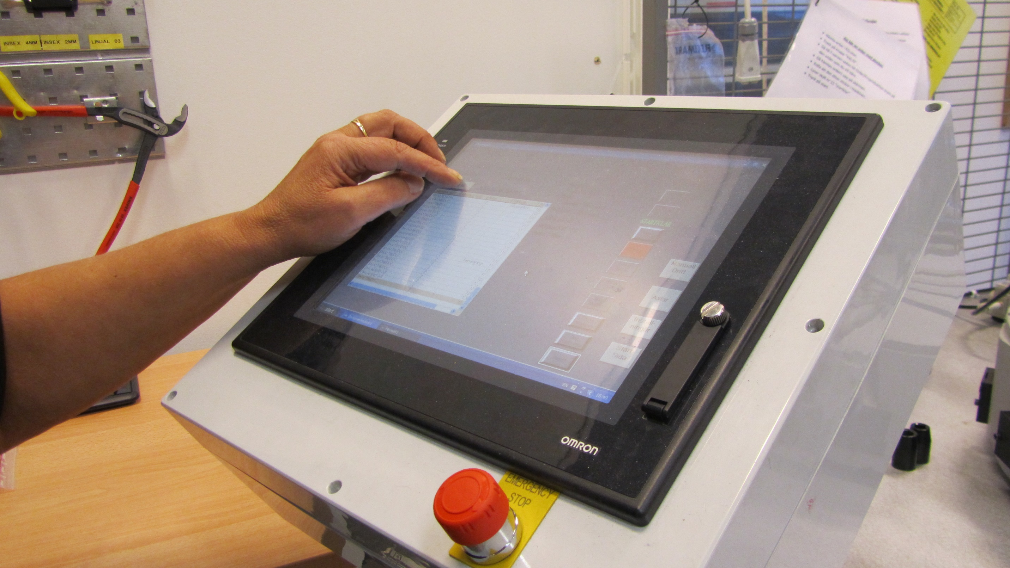

Slide 12
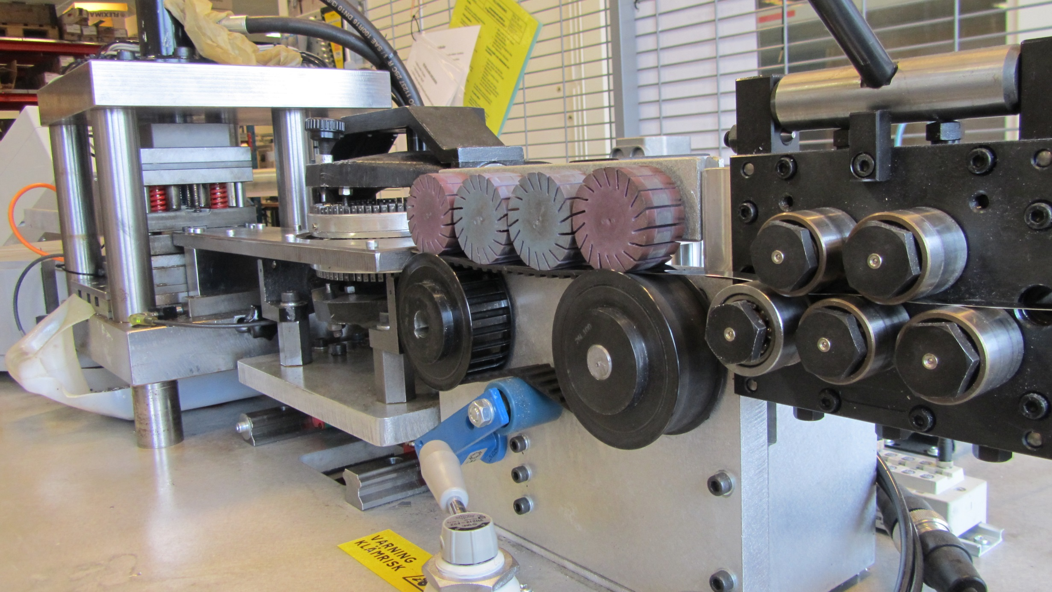

Slide 13
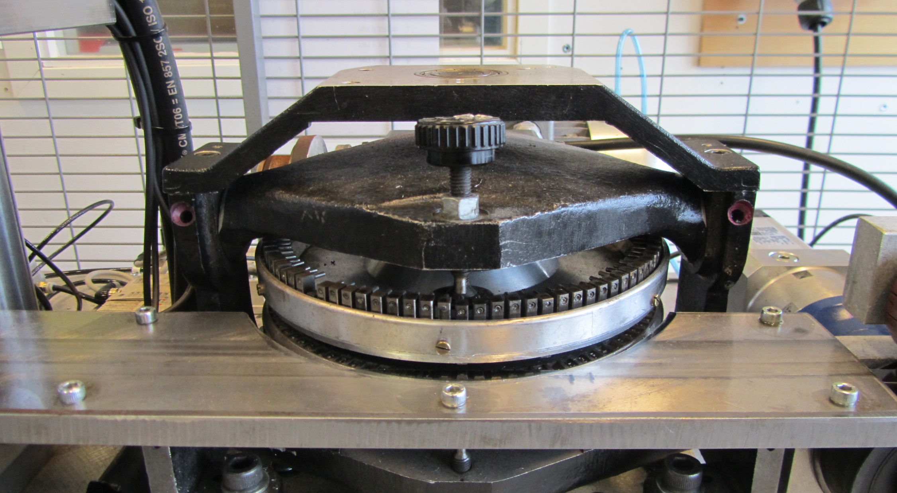

Slide 14
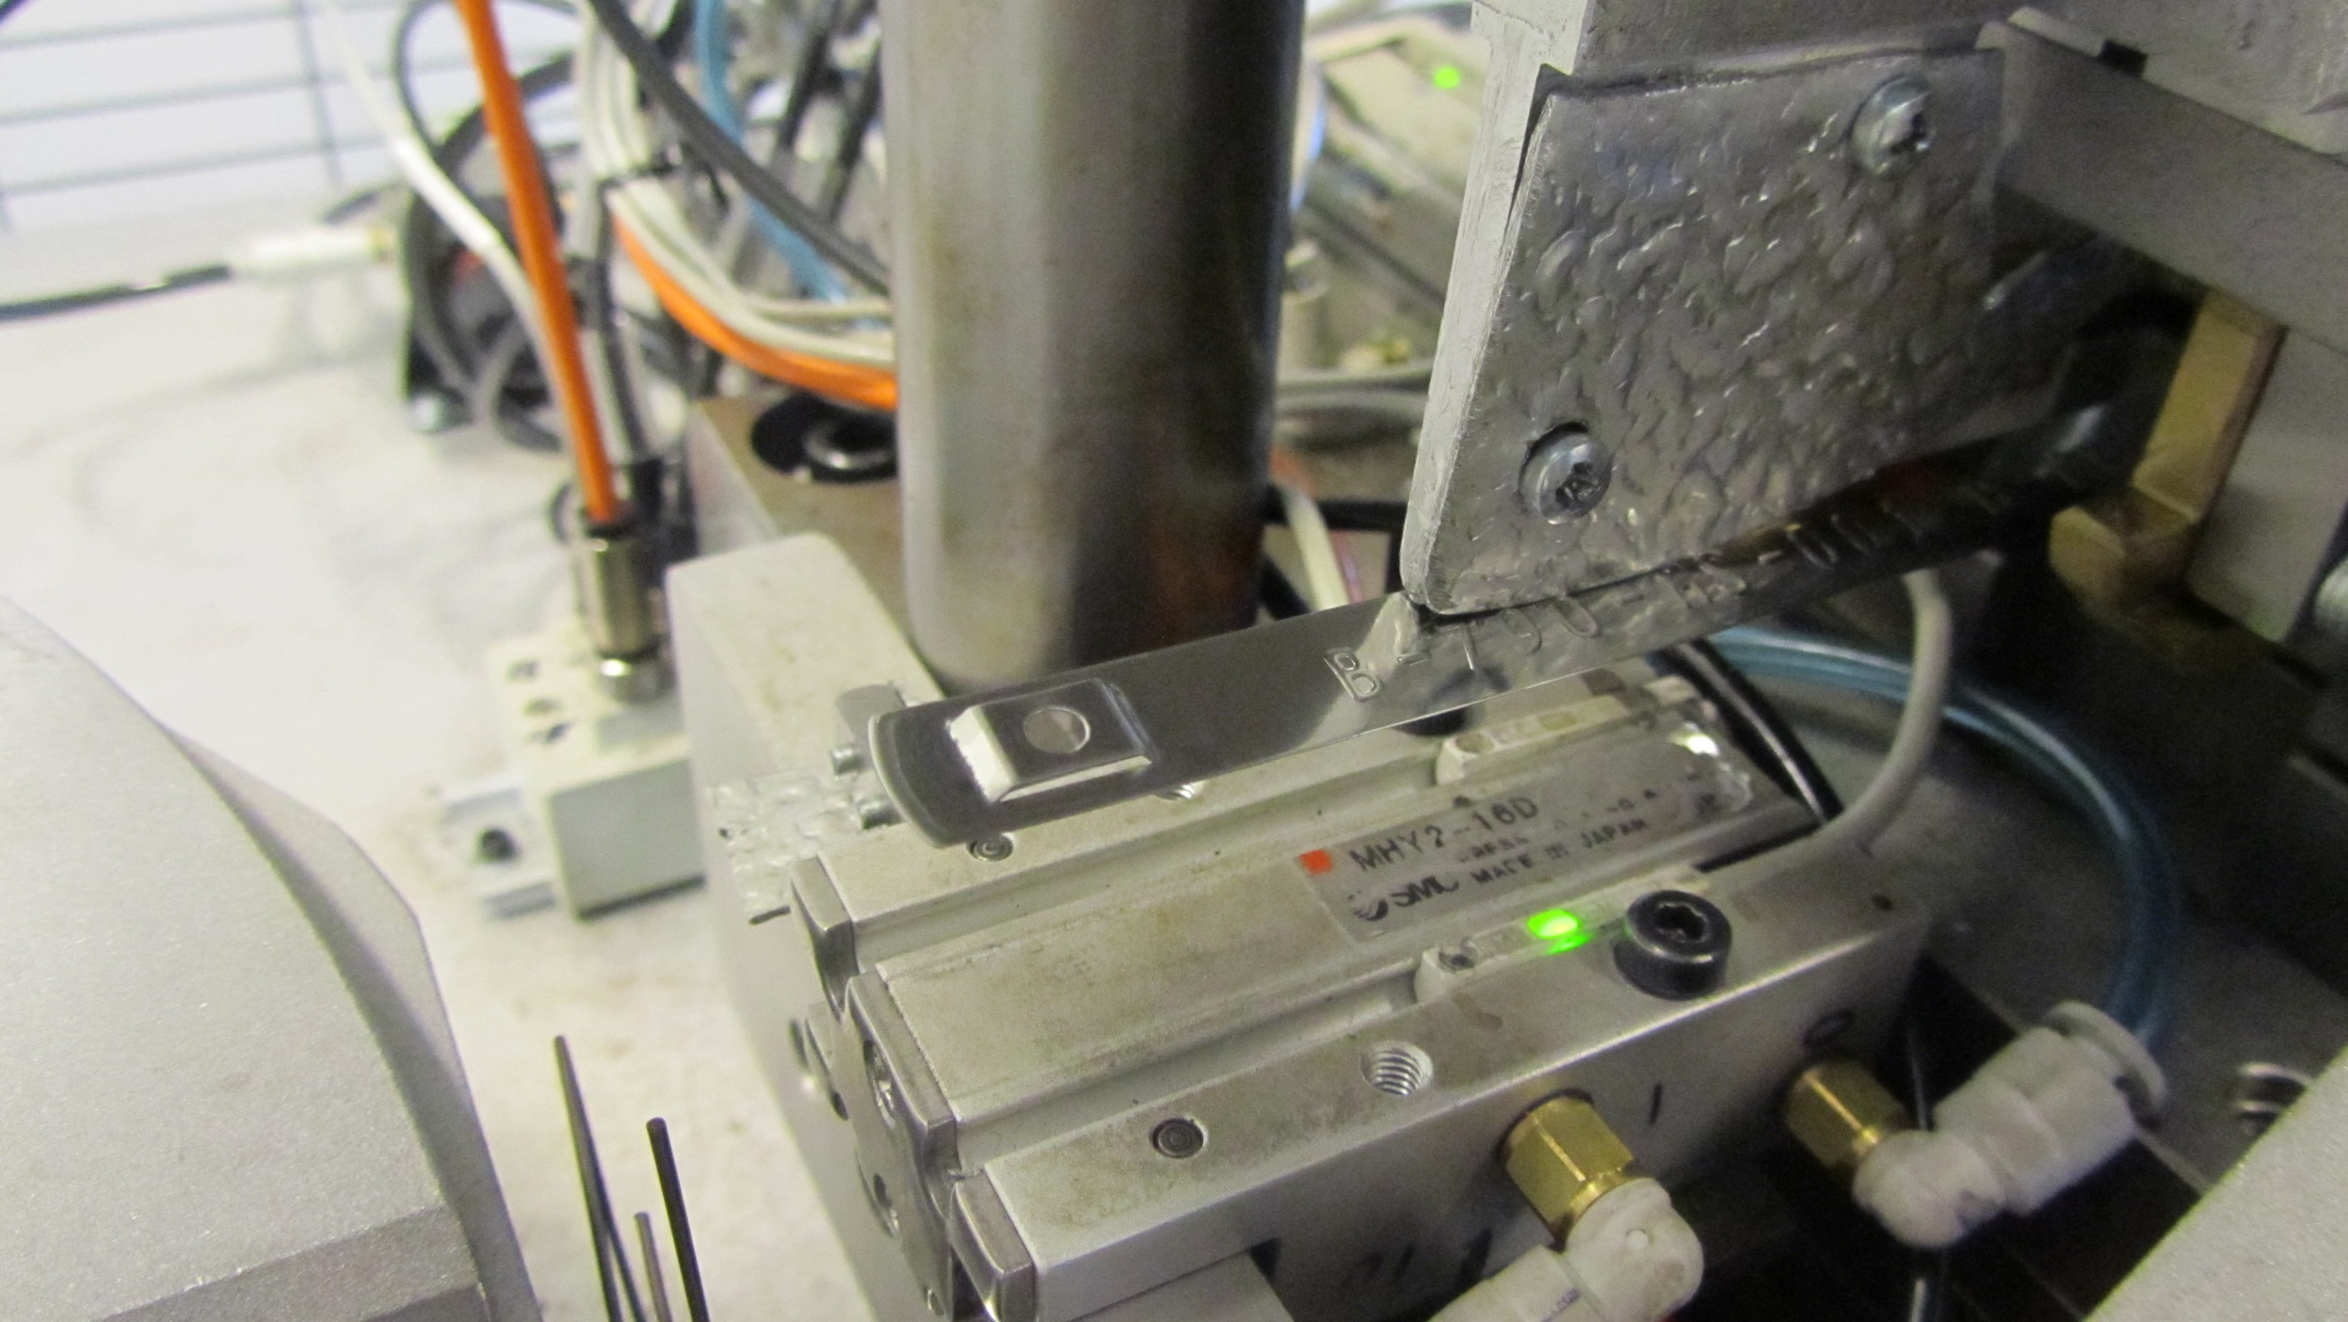

Slide 16
FLEXIMARK® CUSTOMIZED
MARKING SYSTEMS
STAINLESS STEEL MARKING
LABEL MARKING
ENGRAVED MARKING
SHRINKABLE TUBING

Slide 17
WHICH SYSTEM SUITS YOUR INSTALLATION BEST?
- CONSULT OUR EXPERTS!

Slide 18
HIGH FLEXIBILITY AND CLOSE
PROXIMITY TO THE MARKET

