Slide 1
The right cable layout for drag-chains
Webinar ÖLFLEX® CONNECT

Slide 2
Introduction Speaker
Frankie Poo
Lapp Asia Pacific Pte Ltd.
Notes:
Hi my name is Frankie,
I’m from Lapp Asia Pacific, Singapore.
I’m your speaker for the day.
In next minutes, i will cover some basic subjects about cable management in the chain.

Slide 3
1. How to install media (cables, hoses, etc.) correctly
2. How to design multi-layer cable layout for narrow spaces
3. additional Design advice
4. Questions and Answers

Slide 4
How to install media (cables, hoses, etc.) correctly
1.
Notes:
The question: Why is it important to have a propper filling drag-chain system?

Slide 5
Why is it important to have a propper filling drag-chain?
The main reason to increase the service life of the system.
With proper seperators and shelves usage will help to improve the service life of cables and hoses.
Notes:
The next slide, you will see an example. How the service life of the system is affected.
Customer come to us and told us that the existing cable keep failing regularly. Machine is down often, causing him money. He wanted a good product for his application... and based on the information provided, the chain radius, travelling speed, accelerattion, and other parameters, we identified a few cable products which can do the job.
Months later, customer come back us to inform our cable has failed..
We couldn’t believed it either. We request for a visit.. and what we couldn’t believed what we have saw..

Slide 6
Maximum filling

Slide 7
What is the maximum diamater of a cable or a hose permitted in a drag-chain?

Slide 8
Maximum Filling
D
D = Chain Inner height – total clearance (example: D = 50mm)
Max Electric Cables OD: Inner Height-10%
example:
50mm-10% = 45mm
22.5mm + 22.5mm = 45mm
15mm + 15mm + 15mm = 45mm

Slide 9
Maximum Filling
How much clearance do we recommend in the drag-chain for
Electrical round cables
Electrical flat cables
Pneumatic
Hydraulic
Media hoses
10 %
10 %
15 %
20% ~ 30%
30 %

Slide 10
Maximum Filling
How much should a drag-chain be filled?

Slide 11
Maximum Filling
How much should a drag-chain be filled?

Slide 12
Maximum Filling
How much should a drag-chain be filled?

Slide 13
Maximum Filling
How much should a drag-chain be filled?

Slide 14
Maximum Filling
How much should a drag-chain be filled?

Slide 15
Maximum Filling
How much should a drag-chain be filled?
Notes:
In most every day situation, we seeing this.....

Slide 16
Maximum Filling
How much should a drag-chain be filled?
From Lapp, as cable specialist, we recommend not more than 80% of space in the drag-chain.
Notes:
As the manufacturer of drag-chain cable, we recommend do not fill more than 80% space in the chain.

Slide 17
Maximum Filling
This is OK.

Slide 18
Maximum Filling
This is OK too. (situation dependent)

Slide 19
When to use a separator

Slide 20
When to use a separator
Separator not needed, when
Ø1 + Ø2 > D*1.2
Example:
Ø1 = 40 mm
Ø2 = 40 mm
D = 50 mm
40 mm + 40 mm = 80 mm
50 mm * 1.2 = 60 mm 80 > 60 = No Separator Needed
Ø1
(40 mm)
Ø2
(40mm)
D (50 mm)
Notes:
cable 1 + cable 2 total outer diamter dimension value
Chain inner height x 20%

Slide 21
When to use a separator
Separator is needed, when
Separator
Ø3 + Ø4 < D*1.2
Example:
Ø3 = 22 mm
Ø4 = 35 mm
D = 50 mm
22 mm + 35 mm = 57 mm
50 mm * 1.2 = 60 mm
Ø4 (35mm)
D (50 mm)
Ø3 (22mm)
57 < 60 = Separator is Needed

Slide 22
When to use a separator
Separator is needed, when
When cables are
place on top of each
other
D
Notes:
When two cables are place together vertically, you need a separator

Slide 23
When to use a separator
Separator is needed, when
When more cables
are place on top of
each other
D
Notes:
Same rule apply here.
You need a separator
with the thrid cable on to of it.

Slide 24
When to use a separator
Separator is needed, when
or one next to it
D
Notes:
When you have the cable next to it..

Slide 25
When to use a separator
Separator is needed, when
or one next to each
other
D
Separators are Needed
Notes:
Next to each other..

Slide 26
When to use a separator
Separator is needed, when
Two different outer
jacket material are
together
PVC
PUR
D
Separator is Needed

Slide 27
When to use a separator
Separator is needed, when
Two different outer
jacket material are
together
PVC
PUR
D
PVC
PVC

Slide 28
When to use a separator
Separator is needed, when
Two different outer
jacket material are
together
PVC
D
PVC
PVC
PUR
Separators are Needed
Notes:
This is very important when you have application in a cleanroom environement.
A lot time, we hear customer feedback that he have particle from the chain application in cleanroom.
All the material use in that application is cleanroom certified.. But, still have particle.
While there are many reasons behind that, this could be one of them.
This is very common when come to pneumatic hoses.. A lot of people are mixing 2 or 3 different types of tubing in a chain, hence, particle.

Slide 29
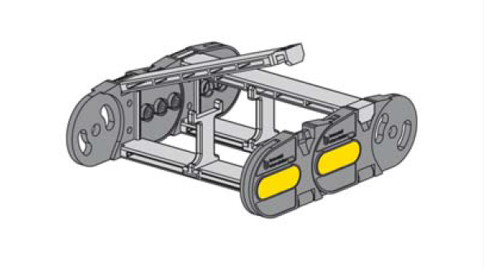
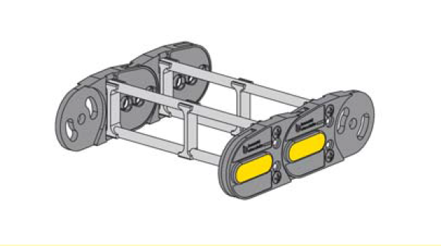
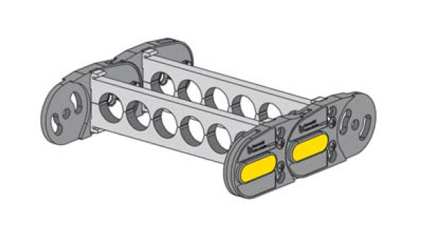
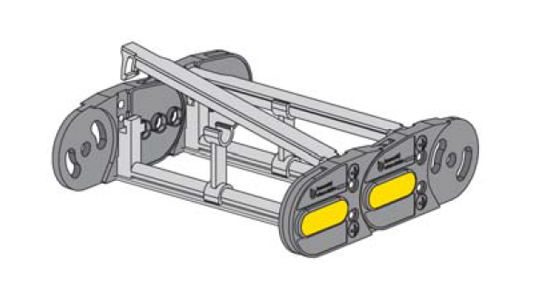
Interior Shelving Examples:
Notes:
There are many design of separators in a chain program... but, they all serve the same function.
These are just few of many which is standard in our chain program.

Slide 30
How to design multi-layer cable layout for narrow spaces
2.
DRAG CHAIN SYSTEM DESIGN - BASIC

Slide 31
Cables laying next to each other (single row)
a) without separator
b) with separators

Slide 32
Cables on top of each other (two rows)
a) with separators
b) with shelving system

Slide 33
Cables on top of each other (three rows)
a) with separators
If possible, avoid placing 3 or more similar and/or different cables or hoses into one cavity compartment.

Slide 34
Design to avoid when possible
What is not so good with this solution?

Slide 35
Design to avoid when possible
Cables in the middle layer cannot be reached when changing them
If the damage cable is pre-assembled with connector, customer will need to remove a lot of cables from the drag-chain to install the replacement cable.

Slide 36
Design to avoid when possible
Cables in the middle layer cannot be reached when changing them
If the damage cable is pre-assembled with connector, customer will need to remove a lot of cables from the drag-chain to install the replacement cable.

Slide 37
Notes:
3 meters application
90 meters application

Slide 40
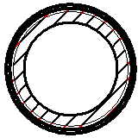
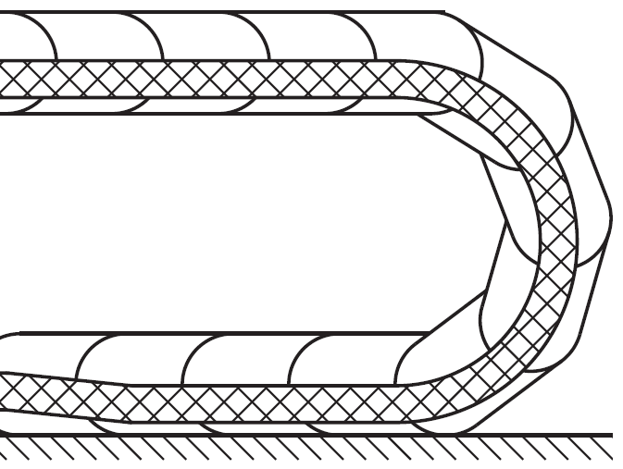
Notes:
The last example..
These are hydraulic hoses.. When pressured, the hydraulic hoses will be stiff.. and take its position..

Slide 41
additional Design advice
3.

Slide 42
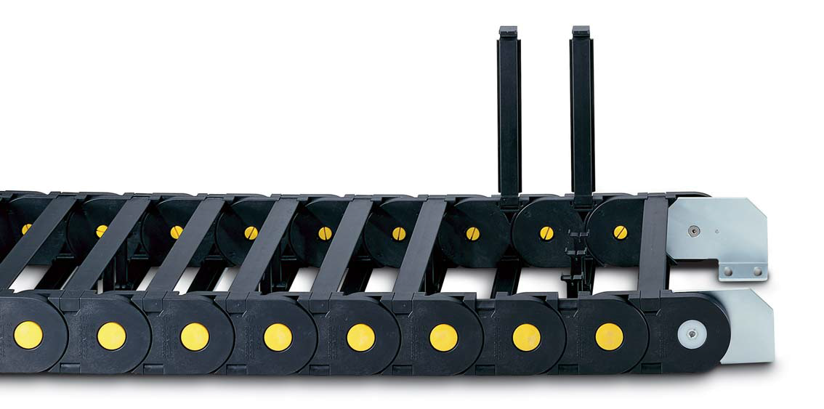
IMPORTANT Design Advice
1. Separators are typically assembled every alternate link
Separators
assembly

Slide 43
IMPORTANT Design Advice
2. The cable‘s weight should be symmetrically distributed along the width of the drag-chain
Air

Slide 44
IMPORTANT Design Advice
2. The cable‘s weight should be symmetrically distributed along the width of the drag-chain

Slide 45
IMPORTANT Design Advice
3. Both cable ends must be fixed with strain relief
Moving End
Fixed End

Slide 46
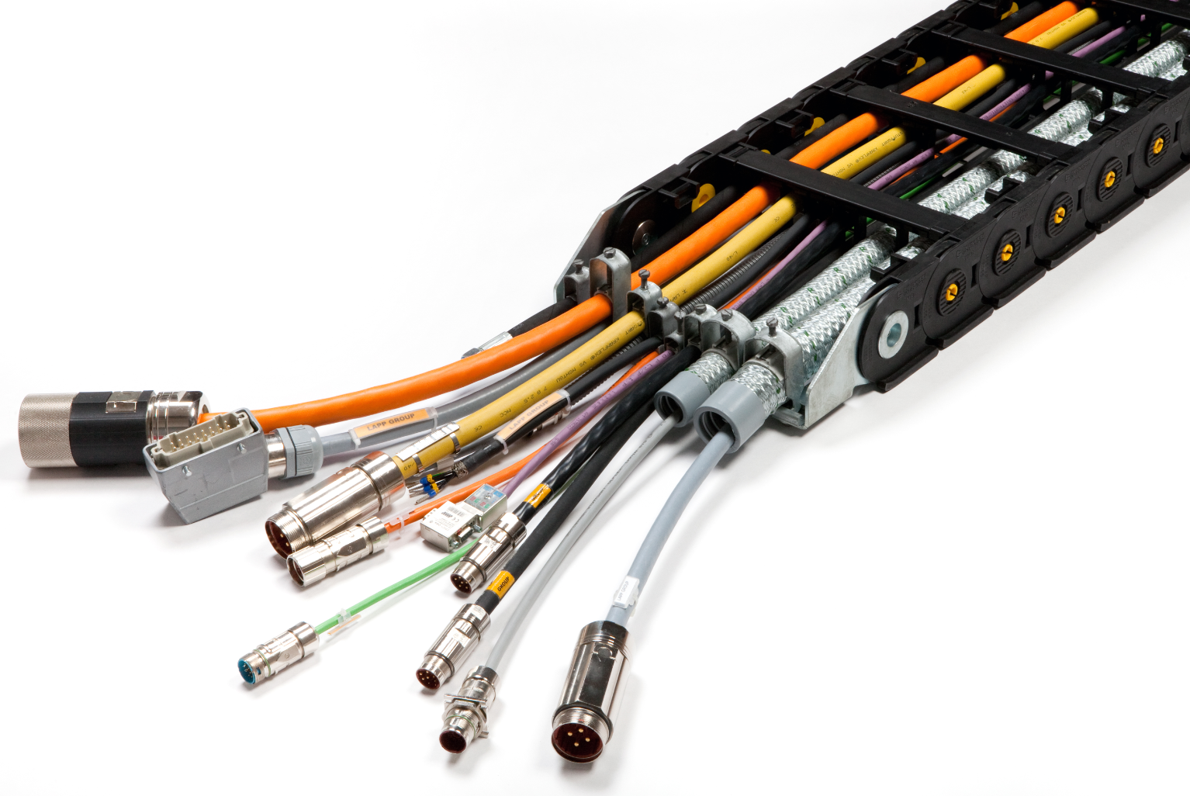
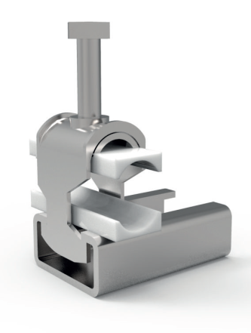
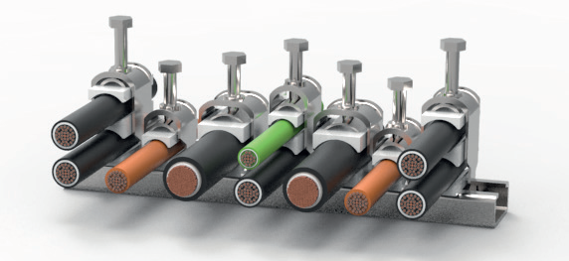
IMPORTANT Design Advice
3. Both cable ends must be fixed with strain relief

Slide 47
IMPORTANT Design Advice
4. Hoses to be fixed at Moving End only.
Moving End
Fixed End

Slide 48
IMPORTANT Design Advice
5. Never tie-wrap or fasten cables or hoses onto carrier system links or cross bars.

Slide 49
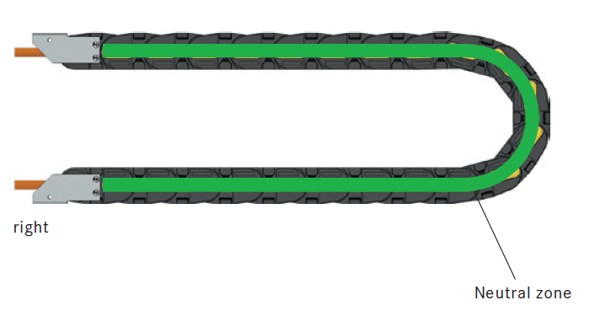
IMPORTANT Design Advice
6. The cables must be able to move freely at bending radius

Slide 50
IMPORTANT Design Advice
7. The cables must be installed „Twist-Free“!

Slide 51
IMPORTANT Design Advice
7. The cables must be installed „Twist-Free“!

Slide 52
IMPORTANT Design Advice
8. Drag Chain Installation done according to recommendation value in the catalogue.

Slide 53
IMPORTANT Design Advice
9. Always consider one extra link, this is to ensure the drag chain ends are rested when at max travel position.

Slide 54
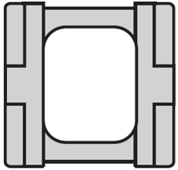
IMPORTANT Design Advice
10. Carrier systems may become unstable when the inner width (C) is less than 2x the inner height (D). Especially when the bending radius (R) selected is greater than 3x the link height.
C
C
D
D

Slide 55
Thanks for your attention!
http://www.lappkabel.com/catalogues.html

